Slide 1
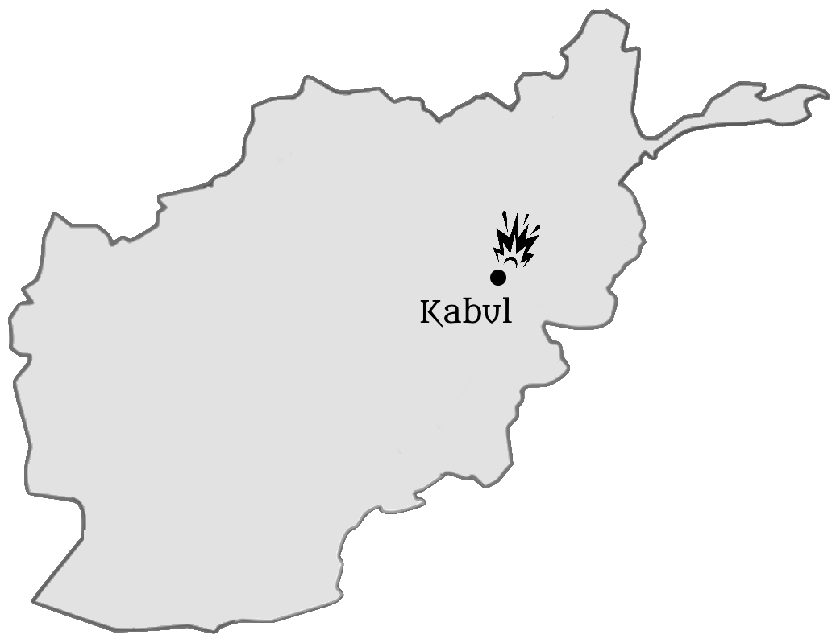
A Time of Disaster
The Christian’s Response
Afghanistan
Notes:
Introduction:
The Pandemic
On March 19, 2020 Governor Abbot put restrictions on public meetings to deal with the COVID outbreak in Texas
At that time there were 5 cases of COVID reported in Tarrant County, 161 in the state, and 3 reported deaths
Very little was known about the virus, but people were scared
As of Thursday, the numbers in Texas: 3.51 million cases. 56,012 deaths
Numbers in USA: 38.4 million cases. 633,000 deaths
Numbers worldwide: 214 million cases, 4.47 million deaths
New Delta variant has brought for a second time, the virus into our own number here at West Side
I know that the numbers, and the way they are reported and arrived at is a matter of debate
Regardless, there is no other circumstance that has impacted our congregation to a greater extent in its entire history.
It has altered where we have met, and how we have conducted our worship services
It has kept some from assembling, and it has taken the life of one of our members.
It has been a difficult 16 months, and there is no end of the Pandemic yet in sight.
National Unrest
Twice the President of the United States was impeached upon Partisan lines
Riots have devastated urban areas from coast to coast, as a result of Racial tensions
Protestors trespassed in Washington DC as they fell upon the Capitol building, resulting in violence, the arrest of over 500 people, and five deaths
Both conservative and liberal leaders in government have been sharply criticized for their approach to the Pandemic
And then, President Joe Biden announced America’s intent to leave on April 14, a little over a month ago.
At the withdrawal of troops, the Taliban took control of Afghanistan in 11 days
The fall of the existing Afghan government necessitated a massive airlift to get Americans and their supporters out of the country.
We woke on Thursday to the news that 2 suicide bombers had detonated in the midst of American soldiers and civilians at Kabul airport, leading to the death of more than a dozen American soldiers, and over 60 Afghans, with many more injured, some seriously.
It has been a difficult 16 months, a difficult few months as the Delta variant has caused a resurgence, and a difficult few days as our peace and welfare as a nation has been again threatened.
I am always a bit hesitant to deal with current events from the pulpit. I will not engage in political debate, and it is not my purpose here to share with you my views of what has been done, what should be done, and what mistakes have been made.
However, our recent study of Revelation has made clear that societal challenges can impact our own faith, leading to discouragement, digression and unfaithfulness
(Revelation 2:10-11) [Church in Smyrna], “Do not fear any of those things which you are about to suffer. Indeed, the devil is about to throw some of you into prison, that you may be tested, and you will have tribulation ten days. Be faithful until death, and I will give you the crown of life. ¹¹ “He who has an ear, let him hear what the Spirit says to the churches. He who overcomes shall not be hurt by the second death.”
With this in mind, I would like to share with you some scriptural principles that should guide us as we respond to the challenges of our time.

Slide 2
Steadfastness in Faith
Do Not Be Discouraged
Psalm 34:17-19; 55:22
Trust in God
Psalm 33:20-22
Afghanistan
Notes:
Our response: Steadfastness in faith
There is no reason to be discouraged as we remember that God is with those who are His
(Psalm 34:17-19), “The righteous cry out, and the Lord hears, and delivers them out of all their troubles. ¹⁸ The Lord is near to those who have a broken heart, and saves such as have a contrite spirit. ¹⁹ Many are the afflictions of the righteous, but the Lord delivers him out of them all.”
(Psalm 55:22), “Cast your burden on the Lord, and He shall sustain you; He shall never permit the righteous to be moved.”
So, the appropriate step during difficulties, disappointments and discouragement is to place your trust in God!
(Psalm 33:20-22), “Our soul waits for the Lord; He is our help and our shield. ²¹ For our heart shall rejoice in Him, because we have trusted in His holy name. ²² Let Your mercy, O Lord, be upon us, just as we hope in You.”

Slide 3
Self-Examination
What are your Priorities?
Matthew 6:31-33
Where is your Allegiance?
Philippians 3:20-21
Afghanistan
Notes:
Our response: Self-examination
It important for us, no matter our situation in life, to constantly reassess to ensure we are pleasing God
It may be, however, during the last year, that events have caused you to consider how unsatisfying this life can be. Are you ready for the one to come?
Do you have your priorities in the right place?
(Matthew 6:31-33), “Therefore do not worry, saying, ‘What shall we eat?’ or ‘What shall we drink?’ or ‘What shall we wear?’ ³² For after all these things the Gentiles seek. For your heavenly Father knows that you need all these things. ³³ But seek first the kingdom of God and His righteousness, and all these things shall be added to you.”
Do you recognize that your primary citizenship is in Heaven?
How do you primarily identify yourself? (This is what occupies your mind and a significant amount of your time).
Do you identify with the political party of which you are a part?
Do you identify as a Texan?
Do you identify as an American?
Our primary focus should be our relationship with Christ!
(Philippians 3:20-21), “For our citizenship is in heaven, from which we also eagerly wait for the Savior, the Lord Jesus Christ, ²¹ who will transform our lowly body that it may be conformed to His glorious body, according to the working by which He is able even to subdue all things to Himself.”
If your allegiance is to God first, it should be evident everyday by the zeal you show for Him.
(Romans 12:11, ESV) [I like the way it is put], “Do not be slothful in zeal, be fervent in spirit, serve the Lord.”
Consider that our first two points have an internal focus (Establishing priorities/self-examination)
However, to really thrive during difficult times, the best thing to do is to focus on others
Consider the following responses that should be characteristic of God’s people

Slide 4
Compassion
Selflessness – Outward focus
Philippians 2:3-4
Following God’s example
2 Corinthians 1:3-4
Afghanistan
Notes:
Compassion:
Compassion is inherently selfless – outward in focus
(Philippians 2:3-4), “Let nothing be done through selfish ambition or conceit, but in lowliness of mind let each esteem others better than himself. ⁴ Let each of you look out not only for his own interests, but also for the interests of others.”
For those who are ill
For those who are in danger (in Afghanistan… vulnerable to the virus, etc.)
I read an article a few days ago, which reported from 3 different sources that the Taliban is going to door, and among other things, demanding people’s cell phones.
The report states that if they find a Bible app on the phone they are killing people immediately.
For the families of those who have been killed or died from virus
God comforts us so that we might comfort others!
(2 Corinthians 1:3-4), “Blessed be the God and Father of our Lord Jesus Christ, the Father of mercies and God of all comfort, ⁴ who comforts us in all our tribulation, that we may be able to comfort those who are in any trouble, with the comfort with which we ourselves are comforted by God.”

Slide 5
Prayer
For Our Leaders
1 Timothy 2:1-4
For All Men
1 John 5:14; James 5:16b
Afghanistan
Notes:
Prayer:
If we have not, we need to broaden our focus as we offer our prayers to God
It’s sad to say, but we can be selfish (or at least too narrow focused in the prayers we offer)
Our entire world (all of humanity) is in need, especially so in recent days
Pray especially for our National, State and Local leaders
(1 Timothy 2:1-4), “Therefore I exhort first of all that supplications, prayers, intercessions, and giving of thanks be made for all men, ² for kings and all who are in authority, that we may lead a quiet and peaceable life in all godliness and reverence. ³ For this is good and acceptable in the sight of God our Savior, ⁴ who desires all men to be saved and to come to the knowledge of the truth.”
(Daniel 2:20-22) [Daniel praised God who had revealed the kings dream to him], “Daniel answered and said: “Blessed be the name of God forever and ever, for wisdom and might are His. ²¹ And He changes the times and the seasons; He removes kings and raises up kings; He gives wisdom to the wise and knowledge to those who have understanding. ²² He reveals deep and secret things; He knows what is in the darkness, and light dwells with Him.”
For our leaders who are making decisions regarding strategy in Afghanistan
For our leaders who are juggling questions of safety and the inevitable conflicts with the personal liberties we treasure
For leaders of every nation to recognize God’s authority and the call to righteousness so that men might come to a knowledge of the truth.
All of humanity is hurting right now, perhaps more than normal, though it is the lot of man to suffer on the earth They need our prayers.
(1 Timothy 2:1), [Our text above], ““Therefore I exhort first of all that supplications, prayers, intercessions, and giving of thanks be made for all men.”
(1 John 5:14), “Now this is the confidence that we have in Him, that if we ask anything according to His will, He hears us.”
For our soldiers & Americans in Afghanistan
For the innocent Afghani refugees
For the families of the dead
For the defeat of tyranny and evil
For the brethren in the Philippines (and other 3rd world countries) who often are in need of the next meal, and basic necessities
Quote from recent Ron Halbrook report about the Philippines: "Recent increases of cases have resulted in new lock downs. Of course, nature’s normal cycles continue with monsoon rains and typhoons, resulting in floods and landslides in some places. In addition, rat infestations have destroyed thousands of acres of crops. God alone knows how many thousands of saints there in the Philippines are suffering from hunger".
For God to have mercy and relieve the Pandemic
For our nation to repent and turn to God
Remember…
(James 5:16b), “The effective, fervent prayer of a righteous man avails much.”

Slide 6
Action
The Exercise of Love
Luke 10:33-35
The Practice of Pure Religion
James 1:27
Afghanistan
Notes:
Action:
Christian love is seen in action
(1 Corinthians 13:4-7), “Love suffers long and is kind; love does not envy; love does not parade itself, is not puffed up; ⁵ does not behave rudely, does not seek its own, is not provoked, thinks no evil; ⁶ does not rejoice in iniquity, but rejoices in the truth; ⁷ bears all things, believes all things, hopes all things, endures all things.”
Consider Jesus’ answer to the scribe’s question about loving your neighbor
(Luke 10:33-35) [The Samaritan who cared for a man who had been robbed and beaten], “But a certain Samaritan, as he journeyed, came where he was. And when he saw him, he had compassion. ³⁴ So he went to him and bandaged his wounds, pouring on oil and wine; and he set him on his own animal, brought him to an inn, and took care of him.”
Such compassionate action is described by James as the practice of pure religion
(James 1:27), “Pure and undefiled religion before God and the Father is this: to visit orphans and widows in their trouble, and to keep oneself unspotted from the world.”
What can you do?
Practice personal benevolence. (Note: There is a GodFundMe account that a brother has set up for the brethren in the Philippines. At present it has $2,880 dollars, contributed by 13 Christians, of a stated goal of $10,000). gf.me/u/z6p9tm
Take food to those who are ill
Actively participate in our Personal Work meeting. Take the sheet every week. (It is posted electronically to the FB group).
Phone calls, texts and encouraging cards to the sick and shut-in.
Limiting our instincts to be critical and to blame (counterproductive at this time).
Be mindful of discouragement (exhort one another)
One special request. Develop relationships with everyone in the congregation. Don’t merely say hello or shake a hand, show an interest in each other’s lives.
Pick someone you do not know well. Where do they work? How is their family? How are they handling the pandemic? How are they feeling? Have you had a meaningful conversation with ALL your brothers and sisters? If not, why not?

Slide 7
What lies behind us and what lies ahead of us are tiny matters to what lies within us. ~ Ralph Waldo Emerson Philippians 4:12-13
Afghanistan
Notes:
Conclusion:
A though provoking quote from the pen of the American poet, Ralph Waldo Emerson
“What lies behind us and what lies ahead of us are tiny matters to what lies within us.”
Considered from a Christian viewpoint. Our faith in Jesus Christ equips us to deal with any and all missteps, reversals and disappointments.
As Paul said,….
(Philippians 4:12-13), “I know how to be abased, and I know how to abound. Everywhere and in all things I have learned both to be full and to be hungry, both to abound and to suffer need. ¹³ I can do all things through Christ who strengthens me.”

